Slide 1

FOLIAR DISEASE DETECTION USING ML AND DEEP LEARNING
Progress report of Major Project
Group No-51
Mentor Name-Prof. Kamal Kant Sharma
BACHELOR OF TECHNOLOGY in INFORMATION TECHNOLOGY
Submitted by
Roll Number | Name | Year | Branch | Section | Outcome (Patent/Research Paper/ Application Project deployable)
2100290130023 | AMAN SINGH | 3 | IT | A | Research Paper
21002901300062 | DEV PRATAP SINGH | 3 | IT | A
2100290130038 | ARPIT PAL | 3 | IT | A
2100290130177 | SUMIT CHAUDHARY | 3 | IT | C
DEPARTMENT OF INFORMATION TECHNOLOGY
KIET GROUP OF INSTITUTIONS, GHAZIABAD, UTTAR PARDESH
(Affiliated to Dr. A.P.J. Abdul Kalam Technical University, Lucknow, UP, India) Odd Semester, Session 2023-24

Slide 2
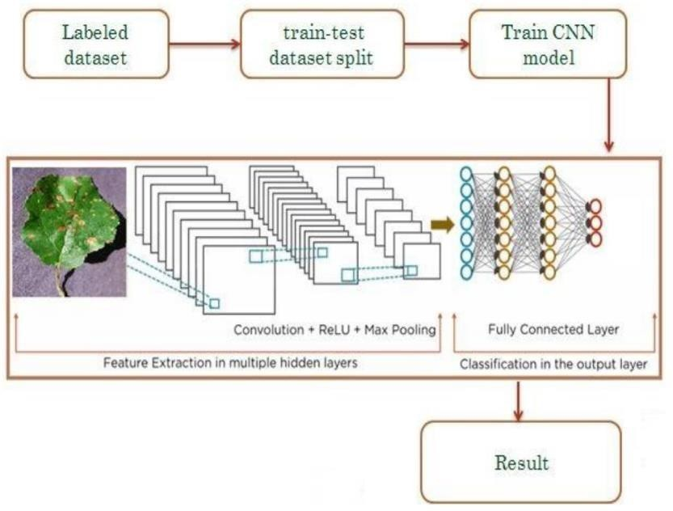
PROPOSED METHODOLOGY
In this section, we discuss pertinent initiatives in categorization problems utilizing deep learning architectures. Deep learning techniques have generally been the subject of much research for applications such as object recognition and image categorization. When used to solve recognition and classification issues, convolutional neural networks (CNNs), a deep learning technology, achieve state-of-the-art performance in picture classification.The first CNN architecture known as MobileNet for object recognition was evaluated using the dataset for tomato disease. To determine the degree of tomato leaf disease from photos of tomato leaves, pre-trained CNN architectures VGG16, MobileNet, and ResNet50 were implemented. Performance was improved by adding ResNet50 features to the traditional CNN model.
Fig 1: Proposed Workflow
The spatial links between the image's constituent parts are not taken into consideration by CNN architectures, making them ineffective for geometric transformations. By routing features from one layer to another in CNN, the max-pooling layer has a tendency to lose data. They are unable to model the rotational invariance of an item.The section presents a Capsule Network with Dynamic Routing algorithm to alleviate the shortcomings of CNN design. Capsule networks were used in the experiments to classify illnesses based on medical imaging, and they performed better than regular CNN in doing so.

Slide 3
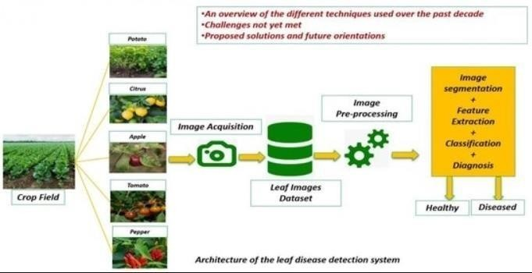
Fig 2: Architecture of the leaf disease detection system
Dataset Classification
Building the CNN using transfer learning
Factorizing Convolutions
Testing
3.1 DATASET CLASSIFICATION
3.2
Selection of proper set of images for training of model is a significant
task.Centroid of each imageis calculated to retrieve select images.Centroid can be calculated by use of contours. Contour is a curve that joins all the points along the periphery of a shape. Contour scan much be detected much precisely on binary images. Hence, every image has to be converted to gray scale with a threshold applie do it.
Having found the contours, the image moments are calculated. Image moments
are used to calculatethe centre of mass or the centroid of an object.The function cv2.Moments return a dictionary of all moment values. From this moments one can extract data such as centroid , area, etc.As we only need centroid of the image, it is given by the relations,
Cx=(M[―m10‖]/M[―m00‖]) and Cy=(M["m01"] /M["m00"]) here,M is the dictionary of moments.

Slide 4
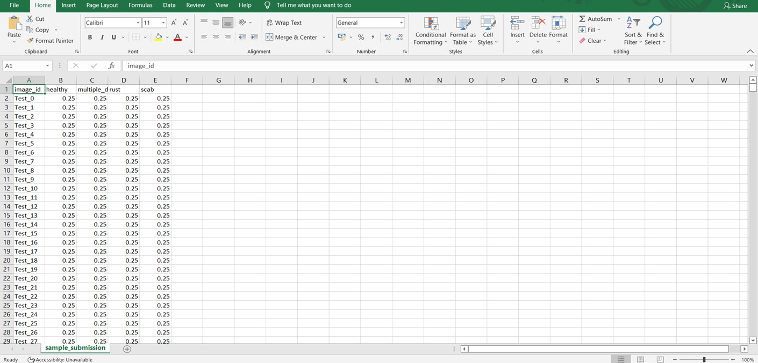
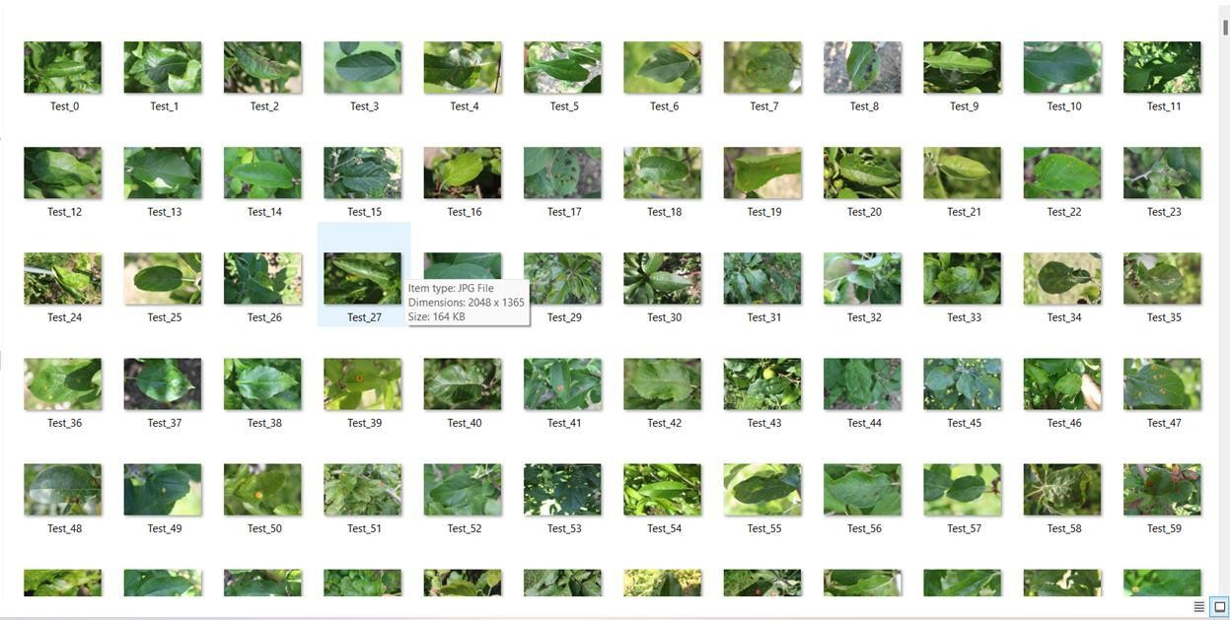
Fig 3: DataSet Examples

Slide 5
BUILDING THE CNN USING TRANSFER LEARNING
Image identification has become feasible with the advent of Convolutional Neural Networks.Butdesigning a CNN that identifies objects and classifies them into distinct classes is a complextask.By making use of transfer learning it can be simplified. In transfer learning we have trained our model that has been trained on Plant Pathalogy dataset .Also Transfer learning significantly reduces training time and gives much better performance for relatively small dataset.
FACTORIZING CONVOLUTIONS
By means of factorizing convolutions the no. of connections and parameters are reduced to aconsiderable degree without adversly affecting the efficiency of the system. Factorization can be into smaller convolutions such as,two 3 by 3 convolutions replace one 5 by 5 convolution; or as symetric convolutions such as 3 by 1 convolution followed by 1 by 3 replaces 3 by 3 convolution.
AUXILARY CLASSIFIER
InInception-v3,auxiliary classifier isused as regularizer. Batch normalization,introduced in Inceptionv2,is also used in the auxiliary classifier.
EFFICIENT GRID SIZE REDUCTION
Usually feature map downsizing is done by maxpooling.But the approach either tends to be too greedy or too expensive. In inception v3 320 feature maps are obatined by max pooling and these are concatenated to obatin 640 feature maps. Efficient grid size reduction inInception v3 produces inexpensive yet effective network. 3) Training the network The deep convolutional model can be used to classify labels specific to the task at hand. For this theInception v3 model is loaded. New classes to be recognised are specified and Inception v3 model is trained over different batches for certain number of epoches, thus harnessing the image classifying abilities of Inception v3 to classify diseased plants.

Slide 6
TESTING
The trained model is tested on a set of images. Random images are introduced to thenetwork and output label is compared to the original known label of the image. Parameters used for evaluation are F1 score,precision and recall.Precision is the proportion of predicted positives that are truly positives. Recall gives the proportion of actual positives correctively classified.F1 score helps in maintaining a balance between precision and recall.
REQUIREMENT ANALYSIS
NON-FUNCTIONAL REQUIREMENTS
Non-functional requirements illustrate how a system must behave and create constraints of its functionality.This type of constraints is also known as the system’s quality features. Attributes such as performance, security, usability, compatibility are notthe feature of the system, they are a required characteristic. They are "developing" properties that emerge from the whole arrangement and hence wecan't compose a particular line of code to execute them. Any attributes required by the user are described by the specification.We must contain only those needs that are appropriate for our design.
Some Non-Functional Requirements areas follows:Availability, Maintainability, Performance, Portability
Scalability, Flexibility.
AVAILABILITY
Availability is a general term used to depict how much an item, gadget, administration, or condition is openby however many individuals as would be prudent. In our venture individuals who have enrolled with the cloud can get to the cloud to store and recover their information with the assistance of a mystery key sent to their emai lids. UI is straight forward and productive and simple to utilize.
MAINTAINABILITY
In programming designing, viability is the simplicity with which a product item can be altered as:Correct absconds Meet new necessities New functionalities can be included in the task based the client necessities just by adding the proper documents to existing venture utilizing ASP. Net and C# programming dialects.

Slide 7
SCALABILITY
Framework is fit for taking care of increment all out throughput under an expanded burden when assets(commonly equipment)are included.Framework can work ordinarily under circumstances, for example, low data transfer capacity and substantial number of clients.
PORTABILITY
Portability is one of the key ideas of abnormal state programming. Convenient is the product code base component to have the capacity to reuse the current code as opposed to making new code while moving programming from a domain to another. Venture can be executed under various activity conditions gave it meet its base setups.Just frame work records congregations would need to be designed in such case.
HARDWARE REQUIREMENTS
Processor | Any Processor Above 500 MHz
RAM | 4GB
HardDisk | 500 GB
System | Intel i3 6Gen 2.4 GHz
Table 1:Hardware Requirements
3.5.8 SOFTWARE REQUIREMENTS
Operating System | Windows
7/8/10/11 Programming language | Python,Machine Learning,CNN
IDE | Jupyter Notebook/Google CollabNoteBook
Tools | Anaconda,Pycharm
Table 2:Software Requirements

Slide 8
3.7 IMPLEMENTATION
The categorised leaves of tomato, potato, grape, and apple plants have 24 distinct types of labels. Information on Apple labels includes the following: healthy rust, scabs, and black rot. specifically:Cercospora of Corn Grey spot, healthy corn, corn blight, and corn rust. The individual grape labelsare Leaf blight, Black rot, Esca, and healthy. The dataset consists of 31,119 images of various produce, including tomatoes, apples, maize, grapes, and potatoes. The images were downsized to 256 x 256 and divided into training and testing datasets with an 80-20 split. Out of the total dataset, 24,000 images were utilized for developing the CNN model.
The dataset includes images of plants affected by different pests and illnesses such as bacterial spot, early blight, healthy, late blight, leaf mould, septoria leaf spot, spider mite, target spot, mosaic virus, and yellow leaf curl virus. The objective of the model is to classify potato images into three categories: early blight, healthy, and late blight, which can help identify and manage diseases effectively. The convolution layer uses a convolution method to extract information. As the depth increases, the complexity of the recovered characteristics increases. The number of filters steadily rises as we move from one block to the next, but their size is constant at 5*5. There are 20 filters in the starting convolution block, 50 in the 2nd, and 80 in the 3rd.
The size of the feature maps was lowered as a result of the pooling layers being used in each of theblocks, which required more filters. After the convolution procedure is used, feature maps are null-padded to retain the dimesnions of the image. To shorten the length, utilise the max pooling layer.Transfer learning is a technique for sharing knowledge that employs 224*224 fixed-size pictures and requires the least amount of training data possible. Transfer learning is useful for transferring knowledge from one model to another. Sentiment analysis, activity recognition, software defect prediction, and plant categorization are just a few of the activities that have utilised transfer learning. In this study, the performance of the suggested Deep CNN model is compared to that of the well-liked VGG16 transfer learning technique. Three layers come after a stack of convolutional layers. The third device employs a 1000-way ILSVRC classification and has 1000 channels, compared to the preceding two devices' 4096 channels apiece. The last layer is the soft- max layer. The entirely connected layer design makes it easier to identify the leaf disease

Slide 9
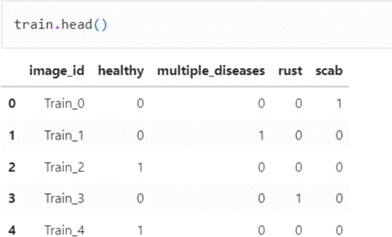
3.6.1 IMPORTING LIABRARIES
Import numpy as np, import pandas as pd,import os,from re import search, import shutil, import natsort, from PIL import Image, import matplotlib.pyplotasplt, from tqdm import tqdm, import cv2.
3.6.2 IMPORTING DATASET
df=r'D:\Python37\Projects\Foliardiseasesinappletrees\images\OriginalDataset'
train=pd.read_csv(r"D:\Python37\Projects\Foliardiseasesinappletree\labels\train.csv") test=pd.read_csv(r"D:\Python37\Projects\Foliardiseasesinappletrees\labels\test.csv")
train.head()
Fig 4: Train Head

Slide 10
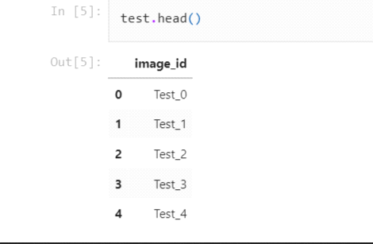
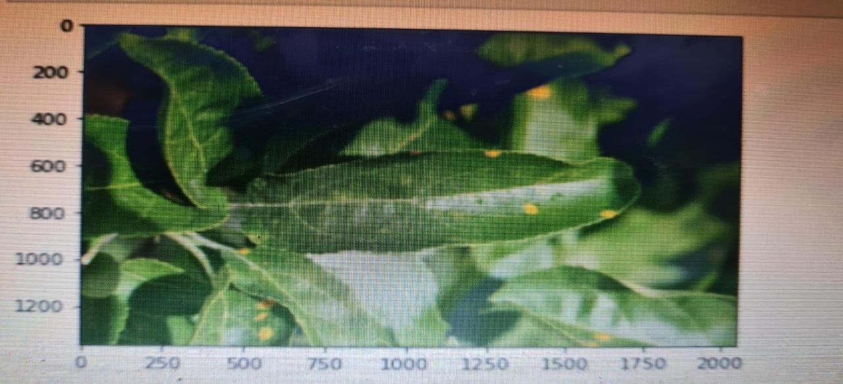
Fig 5: Train Head
image1=Image.open(r'D:\Python37\Projects\Foliardiseasesinappletrees\images\OriginalDataset\Te st_0.jpg')
plt.imshow(image1) plt.show()
Fig 6: Image Showing

Slide 11
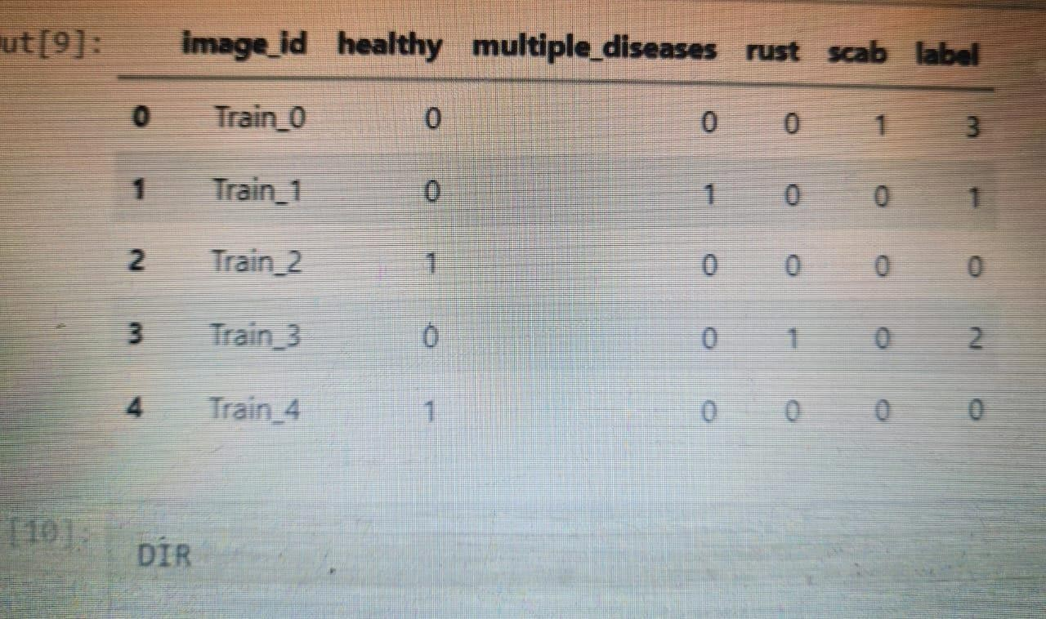
3.6.3 PREPARE THE TRAINING DATA
class_names = train.loc[:,'healthy':].columnsprint(class_names) OUTPUT:Index(['healthy','multiple_diseases','rust','scab'],dtype='object') number=0 train['label']=0
for i in class_names:
train['label'] = train['label'] + train[i] * number number = number+1
train.head()
Fig 7: Training Data

Slide 12
3.6.3 PREPARE THE TRAINING DATA
class_names = train.loc[:,'healthy':].columnsprint(class_names) OUTPUT:Index(['healthy','multiple_diseases','rust','scab'],dtype='object') number=0 train['label']=0
for i in class_names:
train['label'] = train['label'] + train[i] * number number = number+1
train.head()
Fig 7: Training Data

Slide 13
3.6.4 DIR
OUTPUT:'D:\\Python37\\Projects\\Foliar diseases in apple trees\\images\\Original Dataset' nat sort.nat sorted(os.listdir(DIR))
Output:
['Test_0.jpg', 'Test_1.jpg', 'Test_2.jpg', 'Test_3.jpg', 'Test_4.jpg', 'Test_5.jpg', 'Test_6.jpg', 'Test_7.jpg', 'Test_8.jpg', 'Test_9.jpg', 'Test_10.jpg', Test_11.jpg', 'Test_12.jpg','Test_13.jpg', 'Test_14.jpg', 'Test_15.jpg'
,'Test_16.jpg', 'Test_17.jpg' ,'Test_18.jpg', 'Test_19.jpg', 'Test_20.jpg', 'Test_21.jpg', 'Test_22.jpg', 'Test_23.jpg', 'Test_24.jpg', 'Test_25.jpg', 'Test_26.jpg', 'Test_27.jpg', 'Test_28.jpg', 'Test_29.jpg', 'Test_30.jpg', 'Test_31.jpg', 'Test_32.jpg', 'Test_33.jpg',]

Slide 14
3.6.5 CODE IMPLEMENTATION
def get_label_img(img):
if search("Train",img):
img=img.split('.')[0] label=train.loc[train['image_id']==img]['label'] returnlabel
def create_train_data(): images=natsort.natsorted(os.listdir(DIR)) forimgintqdm(images):
label=get_label_img(img) path=os.path.join(DIR,img) ifsearch("Train",img):
if(img.split("_")[1].split(".")[0]) and label.item()==0: shutil.copy(path,r'D:\Python37\Projects\Foliar diseases in apple trees\images\train\healthy')
elif(img.split("_")[1].split(".")[0]) and label.item()==1: shutil.copy(path,r'D:\Python37\Projects\Foliardiseasesinapple trees\images\train\multiple_disease')
elif(img.split("_")[1].split(".")[0]) and label.item()==2: shutil.copy(path,r'D:\Python37\Projects\Foliardiseasesinapple trees\images\train\rust')
elif(img.split("_")[1].split(".")[0]) and label.item()==3: shutil.copy(path,r'D:\Python37\Projects\Foliardiseasesinappletrees\images\train\scab')
elif search("Test",img):

Slide 15
shutil.copy(path,r'D:\Python37\Projects\Foliardiseasesinappletrees\images\test')
shutil.os.mkdir(r'D:\Python37\Projects\Foliardiseasesinapple trees\images\train')
shutil.os.mkdir(r'D:\Python37\Projects\Foliar diseases in apple trees\images\train\healthy')
shutil.os.mkdir(r'D:\Python37\Projects\Foliardiseasesinapple trees\images\train\multiple_disease')
shutil.os.mkdir(r'D:\Python37\Projects\Foliar diseases in apple trees\images\train\rust')
shutil.os.mkdir(r'D:\Python37\Projects\Foliar diseases in apple trees\images\train\scab') shutil.os.mkdir(r'D:\Python37\Projects\Foliardiseases inappletrees\images\test')
3.6.6 DATA PREPROCESSING
Train_DIR=r'D:\Python37\Projects\Foliardiseasesinapple trees\images\train'Categories=['healthy','multiple_disease','rust','scab']
for j in Categories: path=os.path.join(Train_DIR,j) for img in os.listdir(path):
old_image=cv2.imread(os.path.join(path,img),cv2.COLOR_BGR2RGB) plt.imshow(old_image)
plt.show() break break

Slide 16
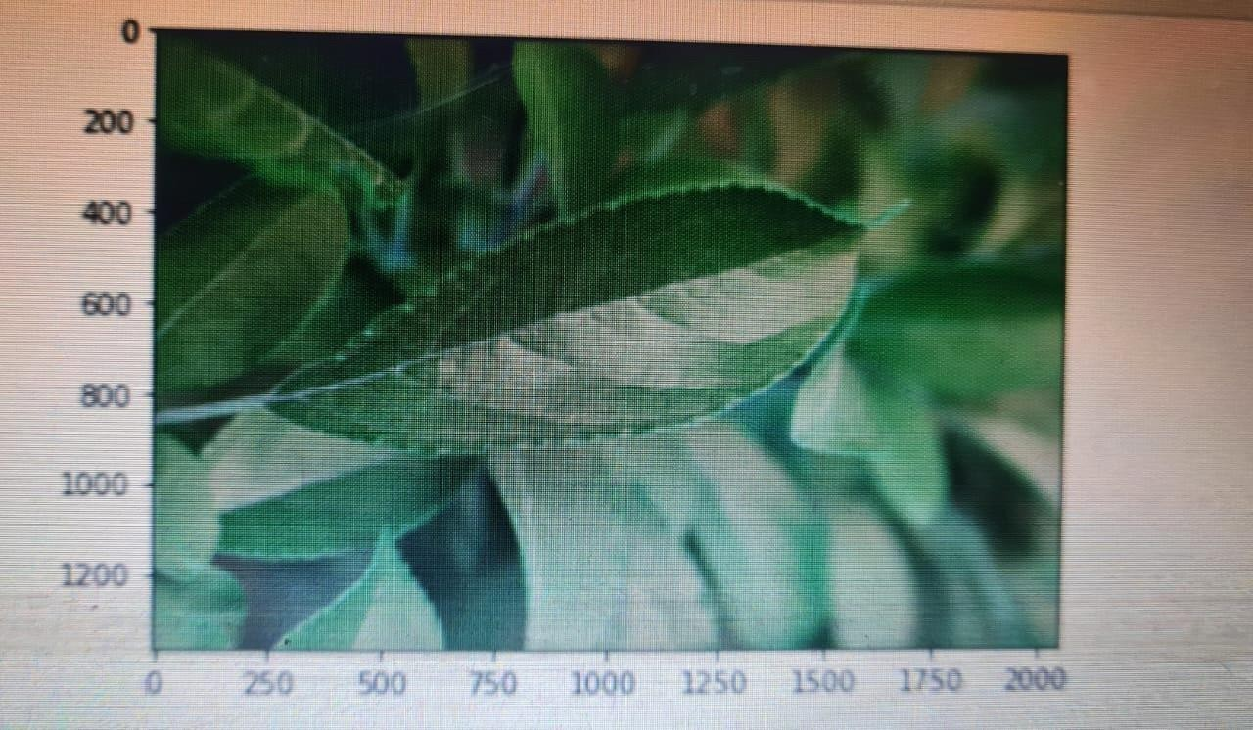
IMG_SIZE=224
new_image=cv2.resize(old_image,(IMG_SIZE,IMG_SIZE)) plt.imshow(new_image)
plt.show()
Fig 8: Data Preprocessing

Slide 17
3.6.7 MODEL PREPRATION
Import tensorflow as tf
from tensorflow.keras.models import Sequential from tensorflow.keras.callbacks
import ModelCheckpoint,EarlyStopping
from tensorflow.keras.preprocessing.image import Image DataGenerator
from tensorflow.keras.layers import Dense,Activation,Flatten,Conv2D,MaxPooling2D
datagen=ImageDataGenerator(rescale=1./255,
shear_range=0.2,
zoom_range=0.2,
horizontal_flip=True,
vertical_flip=True,
validation_split=0.2)
train_datagen=datagen.flow_from_directory(r'D:\Python37\Projects\Foliar trees\images\train', | diseases | in | apple
target_size=(IMG_SIZE,IMG_SIZE),
batch_size=16,
class_mode='categorical',
subset='training')
val_datagen=datagen.flow_from_directory(r'D:\Python37\Projects\Foliar trees\images\train', | diseases | in | apple

Slide 18
target_size=(IMG_SIZE,IMG_SIZE),
batch_size=16,
class_mode='categorical', subset='validation') model=Sequential()
model.add(Conv2D(64,(3,3),activation='relu',padding='same',input_shape=(IMG_SIZE,IMG_SIZ E,3)))
model.add(MaxPooling2D(2,2)) model.add(Conv2D(64,(3,3),activation='relu',padding='same')) model.add(MaxPooling2D(2,2)) model.add(Conv2D(64,(3,3),activation='relu',padding='same')) model.add(MaxPooling2D(2,2)) model.add(Conv2D(128,(3,3),activation='relu',padding='same')) model.add(MaxPooling2D(2,2))
model.add(Flatten()) model.add(Dense(4,activation='softmax'))
3.6.8 COMPILE THE MODEL
model.compile(optimizer=tf.keras.optimizers.Adam(learning_rate=0.001), loss='categorical_crossentropy',
metrics=['accuracy']) model.summary()

Slide 19
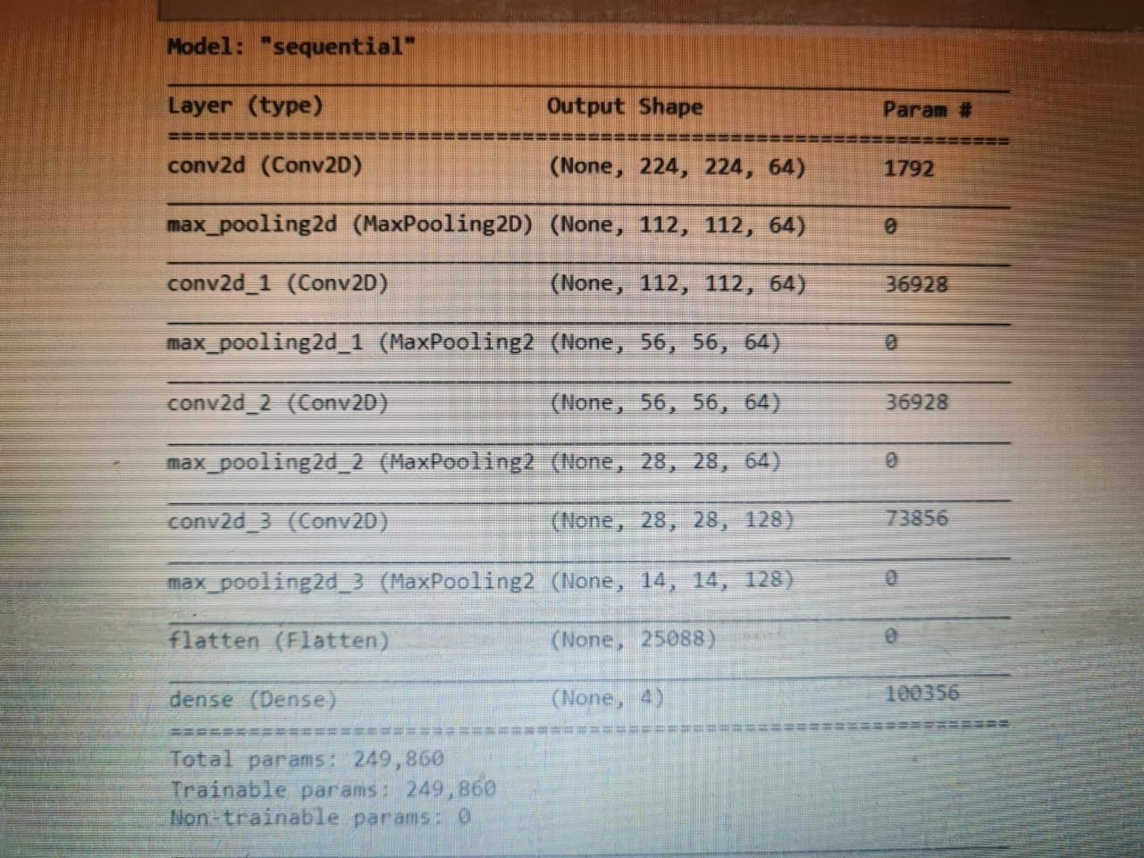
Fig 9: Model Preparation

Slide 20
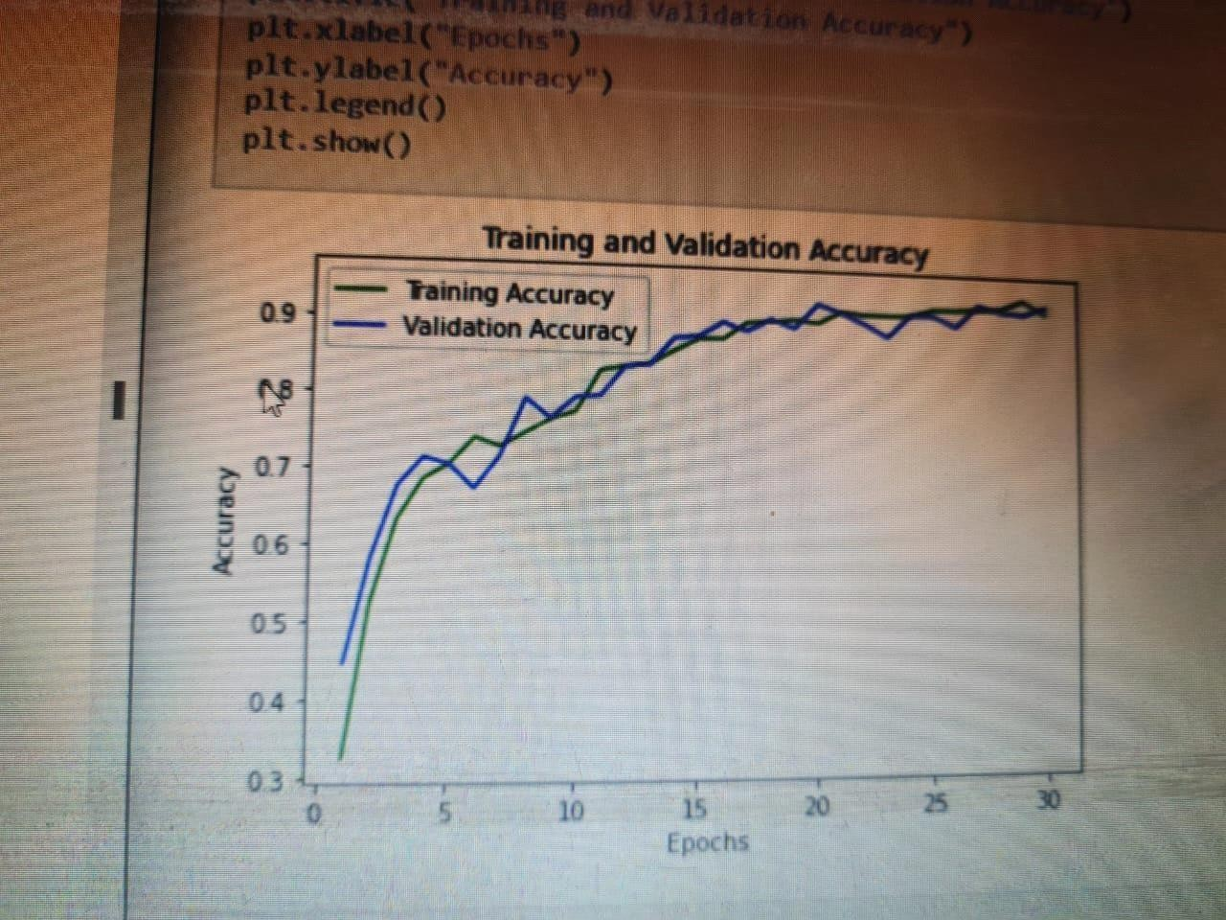
3.6.9 TRAINING AND VALIDATION ACCURACY
acc_train=model_history.history['accuracy'] acc_val=model_history.history['val_accuracy'] epochs=range(1,31) plt.plot(epochs,acc_train,'g',label='TrainingAccuracy') plt.plot(epochs,acc_val,'b',label='ValidationAccuracy') plt.title("TrainingandValidationAccuracy") plt.xlabel("Epochs")
plt.ylabel("Accuracy") plt.legend() plt.show()
Fig 10: Training and Validation Accuracy

Slide 21
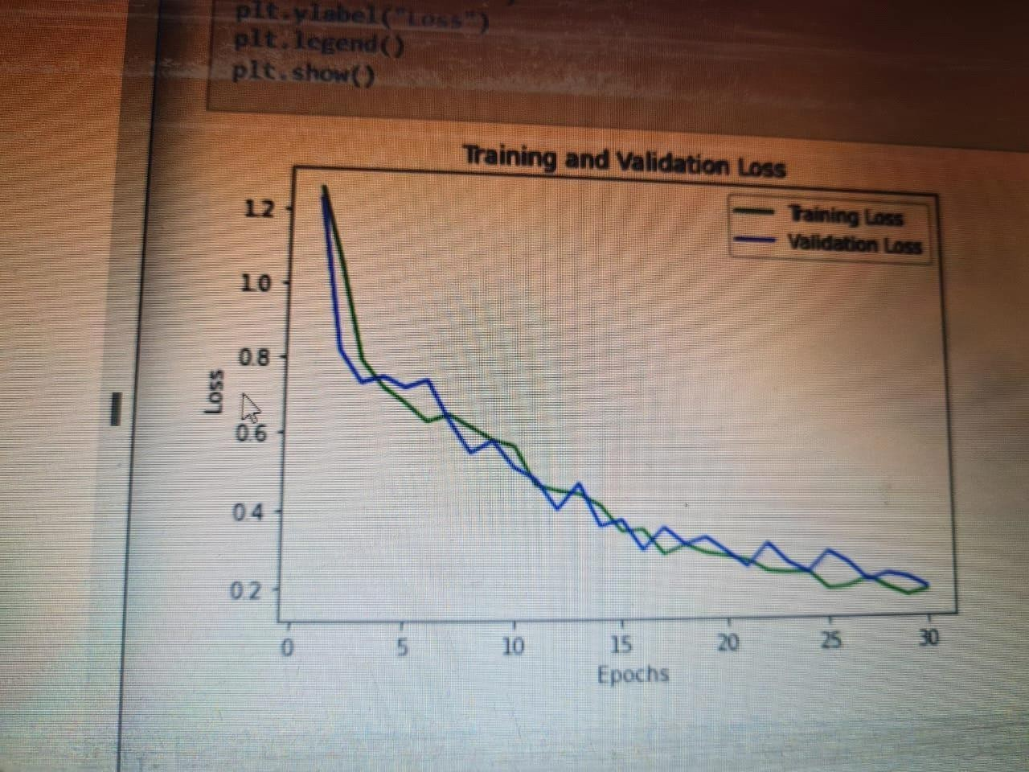
3.6.10 TRAINING AND VALIDATION LOSS
loss_train=model history.history['loss']
loss_val=model_history.history['val loss'] epochs=range(1,31) plt.plot(epochs,loss_train,'g',label='TrainingLoss') plt.plot(epochs,loss_val,'b',label='ValidationLoss')
plt.title("Training andValidation Loss")plt.xlabel("Epochs")plt.ylabel("Loss")plt.legend() plt.show()
Fig 11: Training and Validation Loss

Slide 22
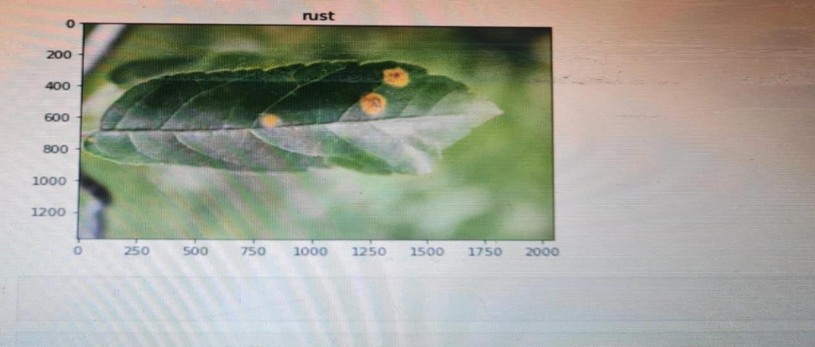
3.6.11 MAKING THE PREDICTIONON A SINGLE IMAGE
test_image=r'D:\Python37\Projects\Foliardiseasesinappletrees\images\train\rust\Train_3.jpg' image_result=Image.open(test_image)
from tensorflow.keras.preprocessing
import imagetest_image=image.load_img(test_image,target_size=(224,224)) test_image=image.img_to_array(test_image)
test_image=test_image/255 test_image=np.expand_dims(test_image,axis=0)
result=model.predict(test_image) print(np.argmax(result))
Categories=['healthy','multiple_disease','rust','scab']
image_result=plt.imshow(image_result) plt.title(Categories[np.argmax(result)) plt.show()
Fig 12: Prediction on Single Image

Slide 23
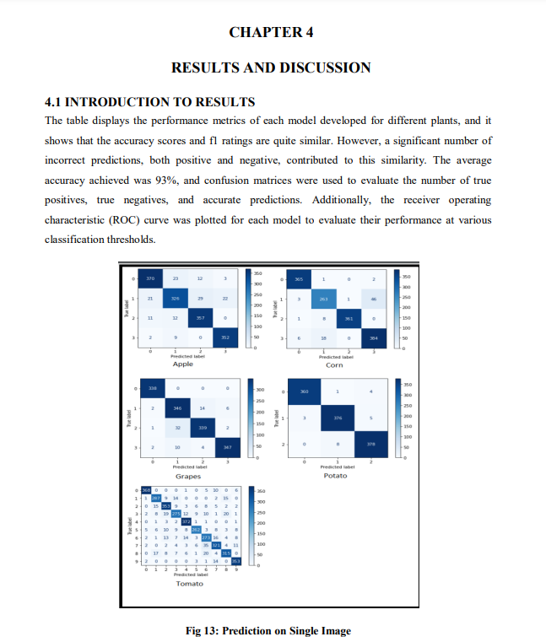

Slide 24
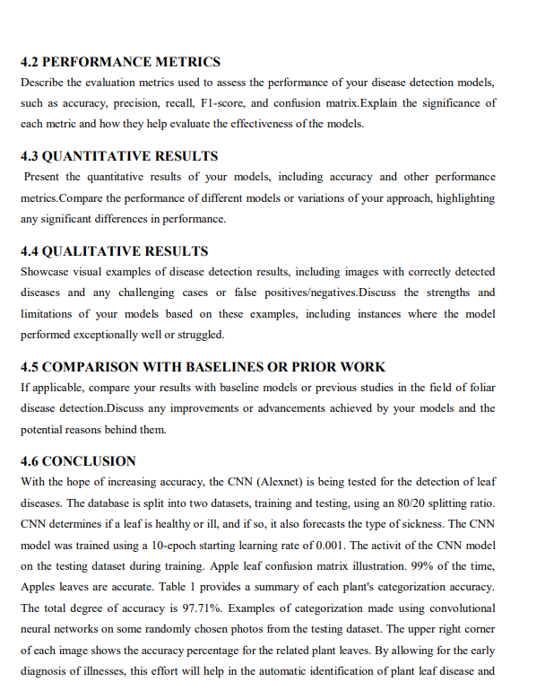

Slide 25
